Slide 1

Senior Design Project
Review-1 Presentation
Deep Learning for Detecting Distracted Drivers
Supervised By: Prof. Priyatosh Mishra
Group No.: U5
Ronik Kumar Das 2141004063
Saugat Mohanty 2141013224
Ankit Mishra 2141013145
Swoyam Prakash Mohanty 2141013226
Department of Computer Sc. and Engineering
Faculty of Engineering & Technology (ITER)
Siksha ‘O’ Anusandhan (Deemed to be) University
Bhubaneswar, Odisha
1

Slide 2
Presentation Outline
Introduction
Project Overview
Problem Statement & Motivations
Objectives & Expected Impact
Literature Review
Existing Solutions
Improvements Over Existing Solutions
Proposed Solution & Architecture
Schematic Layout
Key Components
Algorithms & Tools Used
Progress in Implementation Plan
Summary
Bibliography
2

Slide 3
Introduction
Project overview
Distracted driving is a significant issue worldwide, leading to numerous traffic accidents, injuries, and fatalities.
The increase in electronic device usage while driving, such as texting, making calls, and using in-car technologies, is a key factor.
Addressing the dangers of distracted driving requires urgent and proactive measures to improve road safety.
3

Slide 4
Introduction Contd…
Problem Statement
Functionality: Detects distractions such as texting, calling, eating, or reaching for objects using live video analysis.
Scope: Focused on visual-based detection, excluding biometric sensors or eye-tracking methods.
4

Slide 5
Introduction Contd…
Motivation
Enhancing road safety to reduce high traffic accident rates.
Law enforcement and awareness campaigns are not enough for continuous monitoring.
Deep learning with CNNs enables real-time distracted driver detection.
Provides real-time feedback to prevent accidents and save lives.
Widespread adoption could bring significant societal benefits
5

Slide 6
Introduction Contd…
Objectives & Expected Impact
Develop a deep learning model to classify driver behaviors and detect distractions.
Reduce accidents caused by distractions like texting, eating, or using a phone while driving.
Provide a tool that law enforcement and vehicle manufacturers can integrate into monitoring systems.
Create an open-source, accessible solution for further advancements in the field.
Contribute to research in computer vision and automated driver monitoring systems.
6

Slide 7
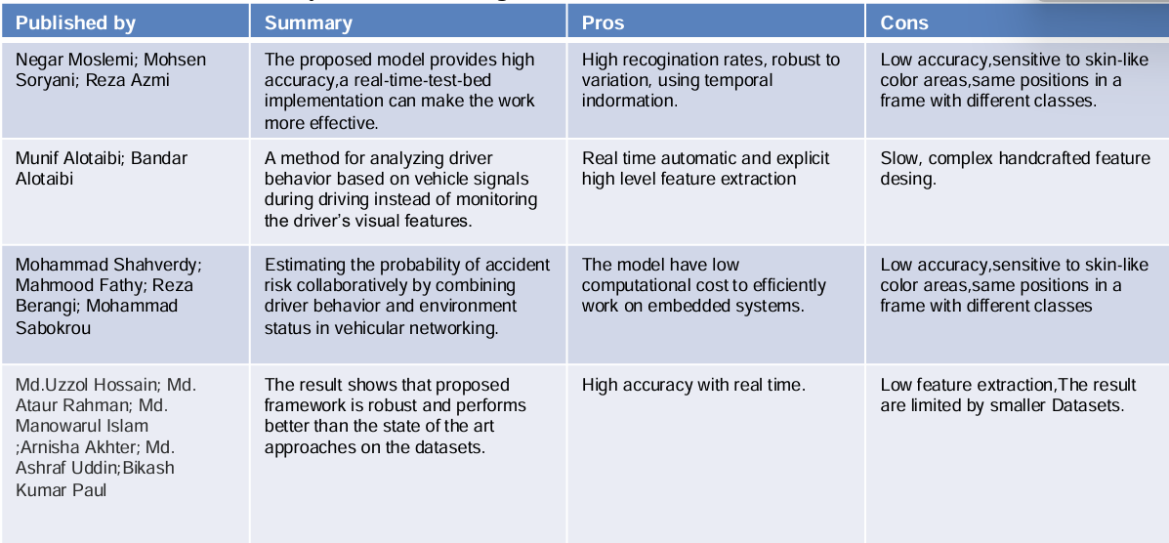
Literature Review
Existing Solutions
Table-1: Literature Survey of the Deep Learning for Detecting Distracted Drivers
7

Slide 8
Literature Review Contd…
Improvements Over Existing Solutions
Automated Data Handling – Faster dataset retrieval & processing.
Optimized Training – Efficient hyperparameters & visualization tools.
Performance Boost – Faster training with better preprocessing.
Higher Accuracy – Advanced augmentation & potential ensemble models.
8

Slide 9
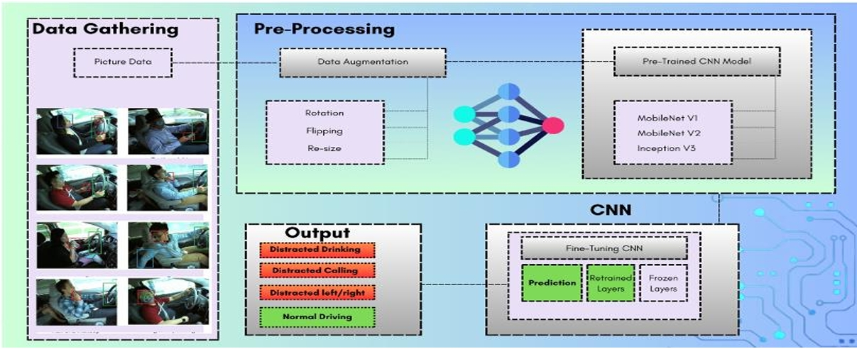
Proposed Solution & Architecture
Schematic Layout
Fig 1: Schematic Layout of our Model
9

Slide 10
Proposed Solution & Architecture Contd…
Key Components
Dataset Handling – Automated data downloading & extraction.
Preprocessing – Data cleaning, augmentation, and transformation.
Model Training – Uses TensorFlow/Keras with optimized parameters.
Performance Optimization – Faster execution & efficient resource usage.
Visualization – Insights using tf_keras_vis for interpretability
10

Slide 11
Proposed Solution & Architecture
Algorithms and Tools Used
Convolutional Neural Network (CNN) model for real-time image classification.
ReLU activation function in convolutional layers, followed by softmax in the fully connected layer for output probabilities.
Optimization: Backpropagation, transfer learning, and hyperparameter tuning for improved accuracy.
Cross-validation: K-fold cross-validation to evaluate model performance.
Computer Vision (OpenCV)Captures real-time video feed and preprocesses frames for model input.
11

Slide 12
Proposed Solution & Architecture
Tools Used
We used Google colab as an interactive programming environment to write and execute our Python code.
Moreover, Pandas ,Numpy, Tensorflow, OpenCV, keras, Matplotlib, and Sklearn Python libraries were used.
12

Slide 13
Progress in Implementation Plan
Completed Tasks:
Dataset Collection & Setup (March 1 - March 5)
Downloaded dataset from Kaggle.
Extracted & organized data for training.
Image Preprocessing (March 5 - March 10)
Resized images & normalized pixel values.
Split data into training & testing sets.
Data Augmentation (March 10 - March 15):
Applying transformations (rotation, zoom, flipping) to increase dataset diversity.
CNN Model Development ( Ongoing: March 15 - March 25)
Build & test the initial CNN architecture.
13

Slide 14
Summary
Developing a real-time distracted driver detection system using deep learning and computer vision to enhance road safety.
Addressing the growing risks of distracted driving by providing an automated and accurate detection system.
Convolutional Neural Networks (CNNs), TensorFlow/Keras, OpenCV, and State Farm Distracted Driver Detection dataset for training.
Improves real-time monitoring and reduces accidents caused by driver distractions.
Can be integrated into smart vehicles and driver assistance systems for proactive safety measures.
14

Slide 15
Bibliography
R. Raghavendra , Theophilus Benson, Mudhakar Srivatsa,Christopher Streiffer, DarNet: A Deep Learning Solution for Distracted Driving, 2017
Chen Huang, Xiaochen Wang, Jiannong Cao, Shihui Wang, and Yan Zhang. "HCF: A Hybrid CNN Framework for Behavior Detection of Distracted Drivers." IEEE Access, vol. 8, pp. 109335-109349, 2020.
S. L. Gallahan, G. F. Golzar, A. P. Jain, A. E. Samay, T. J. Trerotola, Detecting and Mitigating Driver Distraction with Motion Capture Technology: Distracted Driving Warning System, 2013
Mohamed Abouelenien, Rada Mihalcea., Kapotaksha Das, Detection and Recognition of Driver Distraction Using Multimodal Signals, 2022

Slide 16
Bibliography Contd…
L. Fridman, D. E. Brown, M. Glazer, W. Angell, S. Dodd, B. Jenik, L. Terwilliger, J. Kindelsberger, L. Ding, S. Seaman, and B. Mehler, "MIT Advanced Vehicle Technology Study: Large-Scale Naturalistic Driving Study of Driver Behavior and Interaction with Automation," IEEE Access, vol. 7, pp. 102021-102038, 2019
J. Chen, S. Li, and X. Zhou, "Semi-supervised Learning for Driver Distraction Detection Using Convolutional Neural Networks," IEEE Transactions on Neural Networks and Learning Systems, vol. 32, no. 6, pp. 2518-2530, June 2021.
B. Dong, X. Li, and K. Wang, "Comparative Study on Deep Learning Models for Driver Distraction Detection," IEEE Transactions on Intelligent Vehicles, vol. 7, no. 1, pp. 135-146, March 2022
S. Park, J. Kim, and H. Jeong, "Privacy-Preserving Real-Time Detection of Driver Distraction Using Down Sampled Images," IEEE Transactions on Information Forensics and Security, vol. 18, pp. 56-67, 2023

Slide 17

17

